Slide 1

Instruction to Use Grab Simulation Model
Team 24

Slide 2
Contents
1.How u can start running the model
2.Brief description of slider bar
3. Brief description of statistics and plots

Slide 3
How to start?
U can lunch the simulation via open the GrabFood.html inside a browser (JS supported)
If u want to look closer to what the code did:
Main code is at lib/Main.js
AddPlot.js is used for present the graph
Others js files are included as dependency

Slide 4
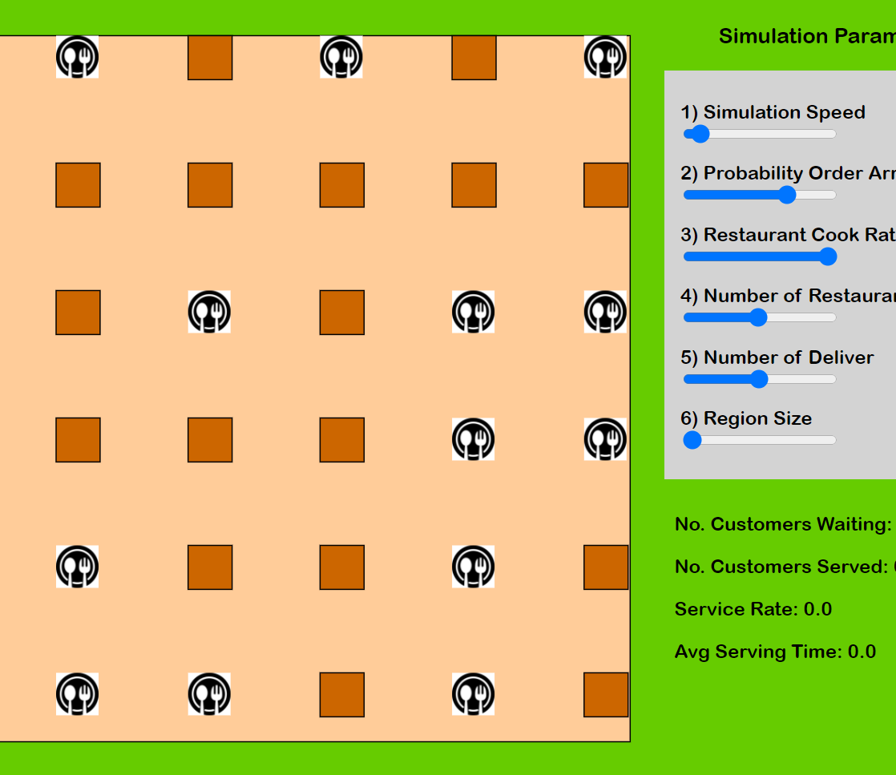
Brief Description of Slider Bar
Overall

Slide 5
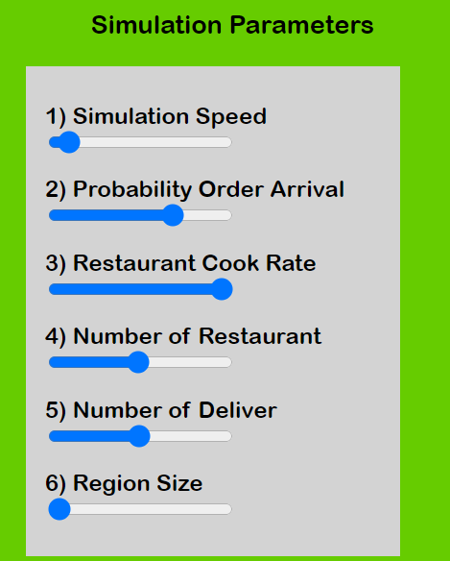
Slider Bar
U can use slider bar to change the simulation parameter.
Speed up / down the simulation
The probability a customer arrive and place an order in the platform
The average cook rate for a restaurant to finish an order
The number of restaurants generated
The number of delivery man generated
Region size to segmented out

Slide 6


More detail on the Slider Bar
Customers are modelled as Bernoulli distribution
Cook Time for restaurant is modelled as Exponential distribution

Slide 7
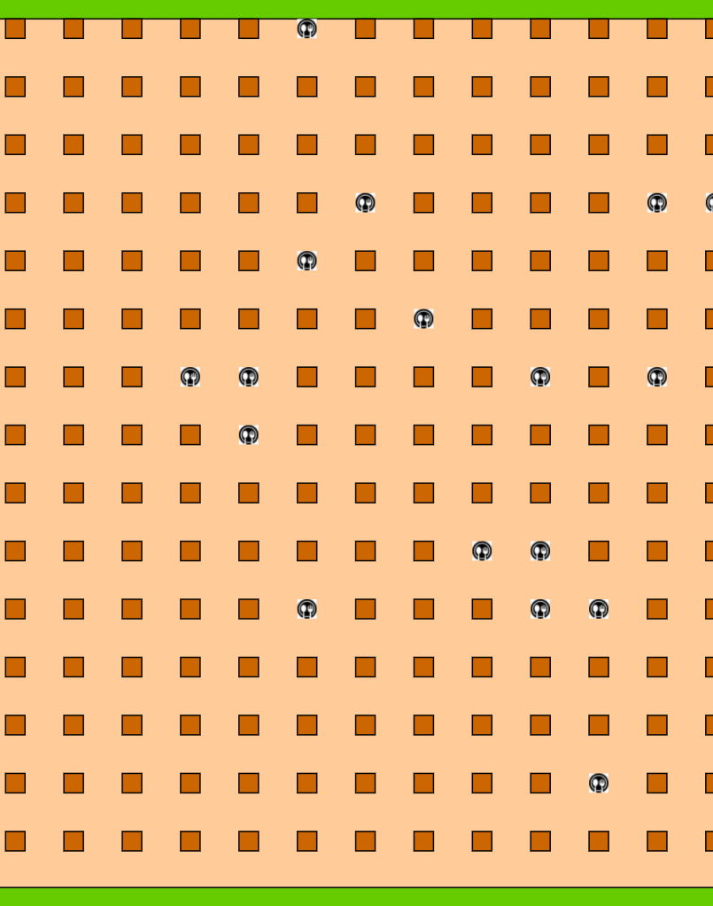
Initialized Values
Region Size is set as 100
Use slider bar to have small size region which is same as segmented out from the initial big size.
Arrival rate :0.7
Restaurant cook rate:1
# of restaurant :20
# of delivery man:25

Slide 8
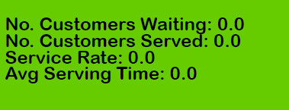
Brief Description of Statistics
Count the Number of customers waiting to serving in the platform
Count the Number of customers already served and EXIT the platform
Service Rate is the proportion of customer served versus customer total admitted
Average serving time for customers already served

Slide 9
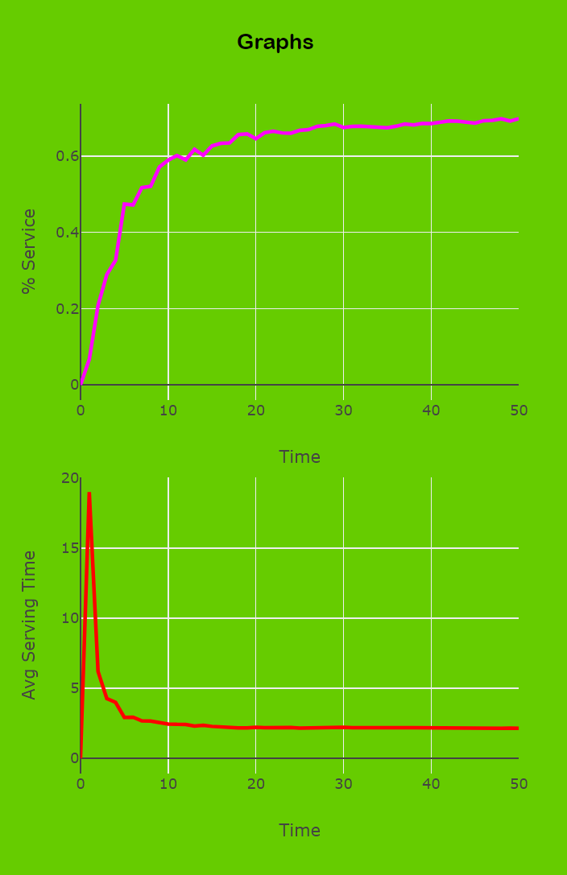
Brief Description of Plot
Graph1: Plot the running service rate
Graph2: Plot the average serving time

Slide 10

Thank you!

